Slide 1
HOUGH TRANSFORM
Presentation by Sumit Tandon
Department of Electrical Engineering
University of Texas at Arlington
Course # EE6358 Computer Vision

Slide 2
Contents
Introduction
Advantages of Hough transform
Hough Transform for Straight Line Detection
Hough Transform for Circle Detection
Recap and list of parameters
Generalized Hough Transform
Improvisation of Hough Transform
Examples
References

Slide 3
1. Introduction
Performed after Edge Detection
It is a technique to isolate the curves of a given shape / shapes in a given image
Classical Hough Transform can locate regular curves like straight lines, circles, parabolas, ellipses, etc.
Requires that the curve be specified in some parametric form
Generalized Hough Transform can be used where a simple analytic description of feature is not possible

Slide 4
2. Advantages of Hough Transform
The Hough Transform is tolerant of gaps in the edges
It is relatively unaffected by noise
It is also unaffected by occlusion in the image

Slide 5
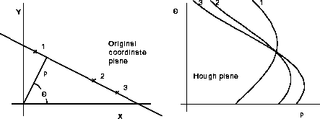
3.1 Hough Transform for Straight Line Detection
A straight line can be represented as
y = mx + c
This representation fails in case of vertical lines
A more useful representation in this case is
Demo

Slide 6
3.2 Hough Transform for Straight Lines
Advantages of Parameterization
Values of ‘ρ’ and ‘θ’ become bounded
How to find intersection of the parametric curves
Use of accumulator arrays – concept of ‘Voting’
To reduce the computational load use Gradient information

Slide 7
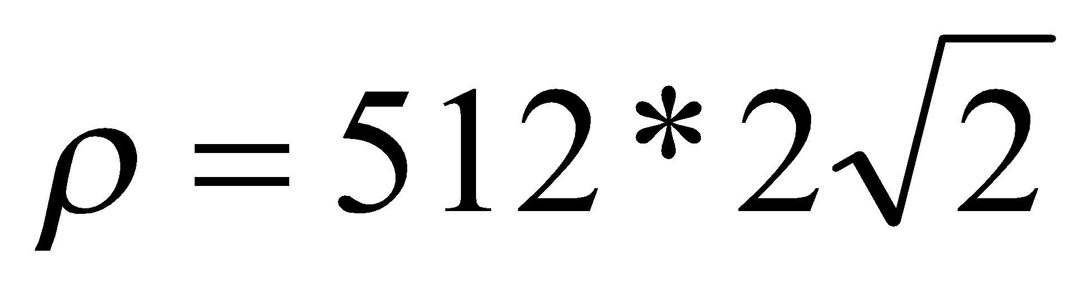
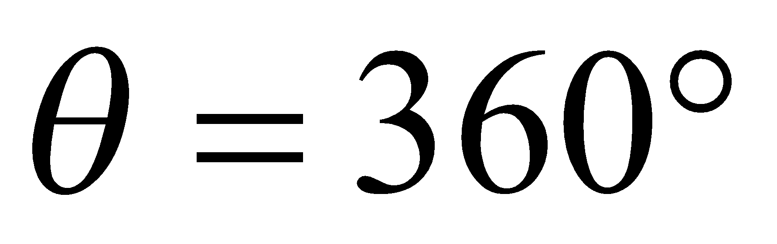
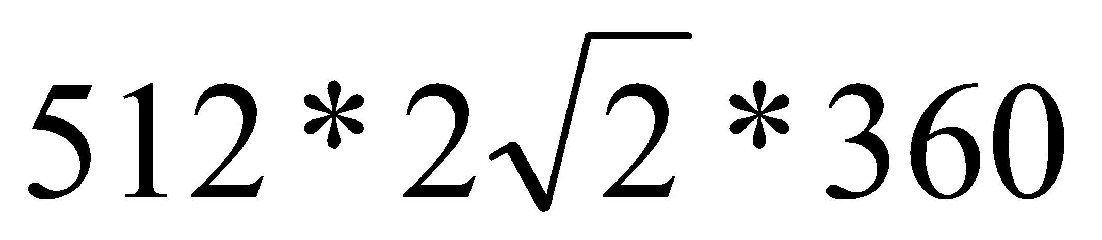
3.3 Computational Load
Image size = 512 X 512
Maximum value of
With a resolution of 1º, maximum value of
Accumulator size =
Use of direction of gradient reduces the computational load by 1/360

Slide 8
3.4 Hough Transform for Straight Lines - Algorithm
Quantize the Hough Transform space: identify the maximum and minimum values of ρ and θ
Generate an accumulator array A(ρ, θ); set all values to zero
For all edge points (x_{i}, y_{i}) in the image
Use gradient direction for θ
Compute ρ from the equation
Increment A(ρ, θ) by one
For all cells in A(ρ, θ)
Search for the maximum value of A(ρ, θ)
Calculate the equation of the line
To reduce the effect of noise more than one element (elements in a neighborhood) in the accumulator array are increased

Slide 9


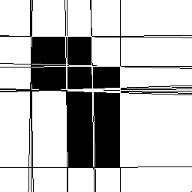
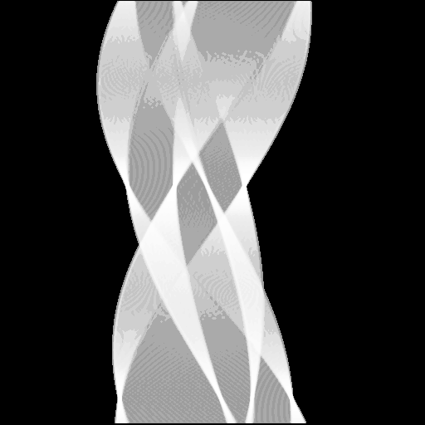
3.5 Line Detection by Hough Transform

Slide 10
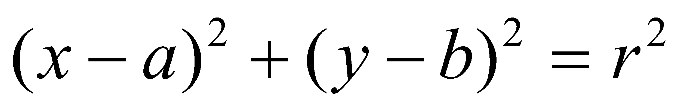
4.1 Hough Transform for Detection of Circles
The parametric equation of the circle can be written as
The equation has three parameters – a, b, r
The curve obtained in the Hough Transform space for each edge point will be a right circular cone
Point of intersection of the cones gives the parameters a, b, r

Slide 11
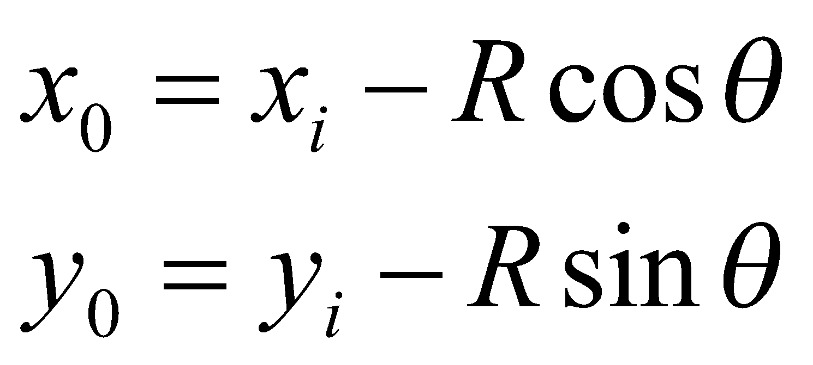
4.2 Hough Transform for Circles
Gradient at each edge point is known
We know the line on which the center will lie
If the radius is also known then center of the circle can be located

Slide 12
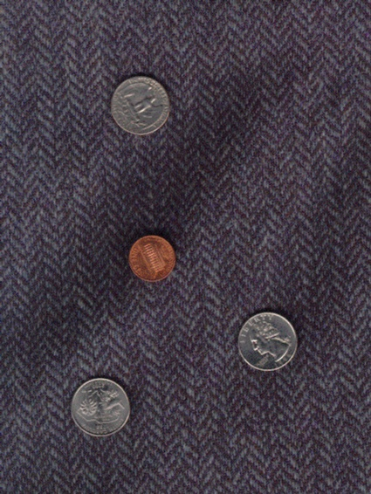
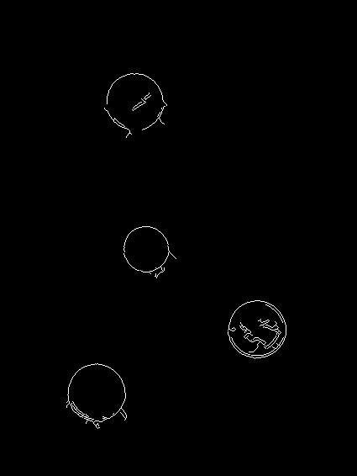
4.3 Detection of circle by Hough Transform - example
Original Image Circles detected by Canny Edge Detector

Slide 13
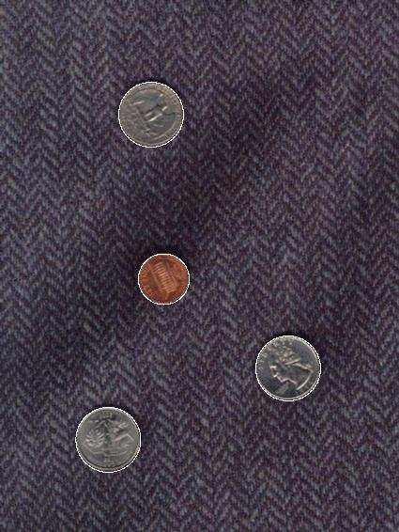
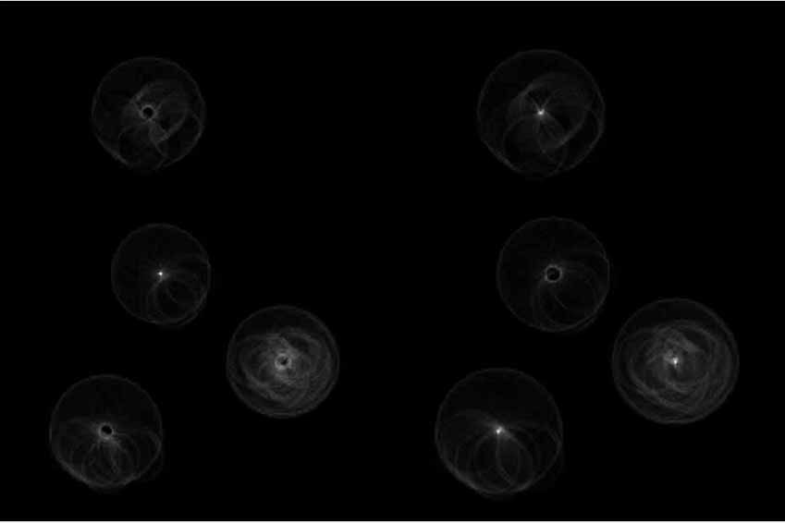
4.4 Detection of circle by Hough Transform - contd
Hough Transform of the edge detected image Detected Circles

Slide 14
5.1 Recap
In detecting lines
The parameters ρ and θ were found out relative to the origin (0,0)
In detecting circles
The radius and center were found out
In both the cases we have knowledge of the shape
We aim to find out its location and orientation in the image
The idea can be extended to shapes like ellipses, parabolas, etc.

Slide 15
5.2 Parameters for analytic curves
Analytic Form
Parameters
Equation
Line
ρ, θ
xcosθ+ysinθ=ρ
Circle
x₀, y₀, ρ
(x-x_{o})²+(y-y₀)²=r²
Parabola
x₀, y₀, ρ, θ
(y-y₀)²=4ρ(x-x_{o})
Ellipse
x₀, y₀, a, b, θ
(x-x_{o})²/a²+(y-y₀)²/b²=1

Slide 16
6.1 Generalized Hough Transform
The Generalized Hough transform can be used to detect arbitrary shapes
Complete specification of the exact shape of the target object is required in the form of the R-Table
Information that can be extracted are
Location
Size
Orientation
Number of occurrences of that particular shape

Slide 17
6.2 Creating the R-table
Algorithm
Choose a reference point
Draw a vector from the reference point to an edge point on the boundary
Store the information of the vector against the gradient angle in the R-Table
There may be more than one entry in the R-Table corresponding to a gradient value

Slide 18
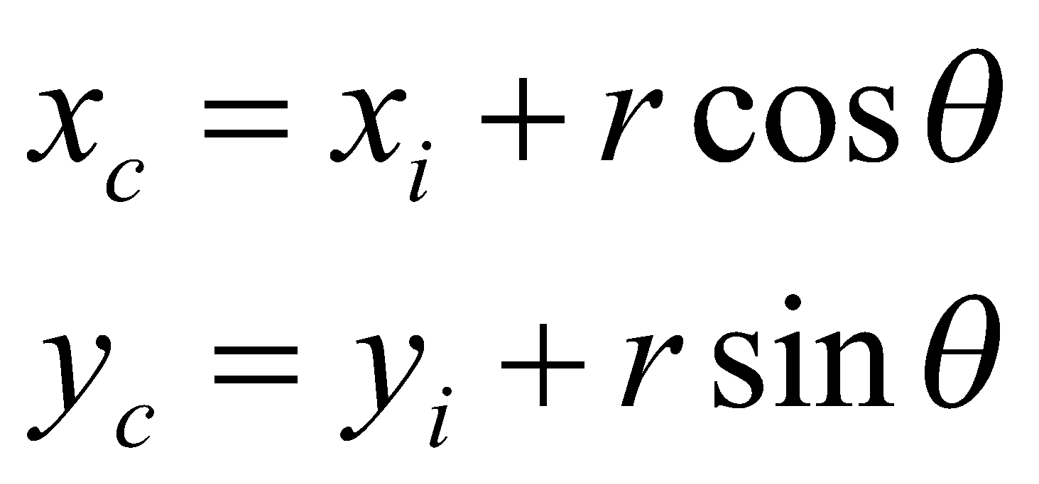
6.3 Generalized Hough Transform - Algorithm
Form an Accumulator array to hold the candidate locations of the reference point
For each point on the edge
Compute the gradient direction and determine the row of the R-Table it corresponds to
For each entry on the row calculate the candidate location of the reference point
Increase the Accumulator value for that point
The reference point location is given by the highest value in the accumulator array

Slide 19
6.4 Generalized Hough Transform – Size and Orientation
The size and orientation of the shape can be found out by simply manipulating the R-Table
For scaling by factor S multiply the R-Table vectors by S
For rotation by angle θ, rotate the vectors in the R-Table by angle θ

Slide 20
6.5 Generalized Hough Transform – Advantages and disadvantages
Advantages
A method for object recognition
Robust to partial deformation in shape
Tolerant to noise
Can detect multiple occurrences of a shape in the same pass
Disadvantages
Lot of memory and computation is required

Slide 21
7.1 Improvisation of the Hough transform for detecting straight line segments
Hough Transform lacks the ability to detect the end points of lines – localized information is lost during HT
Peak points in the accumulator can be difficult to locate in presence of noisy or parallel edges
Efficiency of the algorithm decreases if image becomes too large
New approach is proposed to reduce these problems

Slide 22
7.2 Spatial decomposition
This technique preserves the localized information
Divide the image recursively into quad-trees, each quad-tree representing a part of the image i.e. a sub-image
The leaf nodes will be voted for feature points which are in the sub-image represented by the leaf node

Slide 23
7.2 Spatial Decomposition of Hough Transform
Parameter space is defined from a global origin rather than a local one
Each node contains information about the sub-nodes as well as the number of feature points in the sub-image represented by the node
Pruning of sub-trees is done if the number of the feature points falls below a threshold
An accumulator is assigned for each leaf node

Slide 24
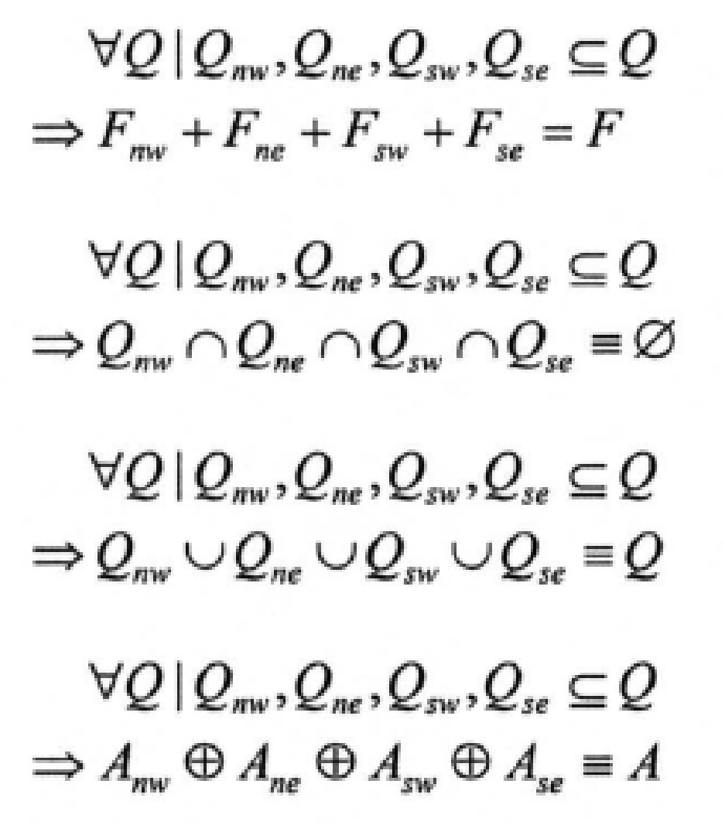
7.3 Some relations involved in spatial decomposition
Consider the following
Q – any non-leaf node
F – feature points in the sub-image represented by this node
A – parameter space of the sub-image
The following relations hold true

Slide 25
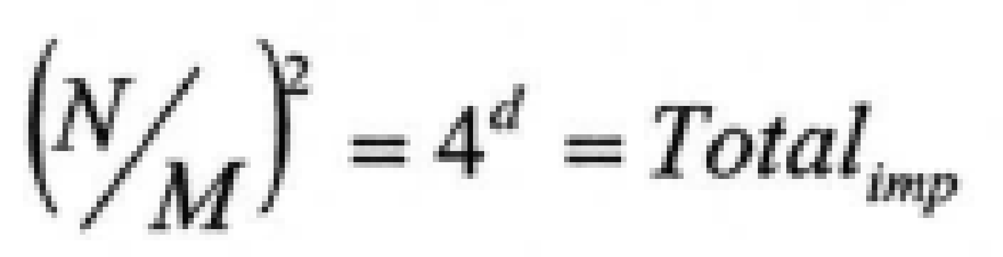

7.4 Number of accumulator arrays required
Consider the following case
Size of image = N X N
Size of leaf node = M X M
Depth of tree = d (root node = 0)
Number of accumulator arrays for only leaf nodes =
Number of accumulator arrays for all nodes =

Slide 26
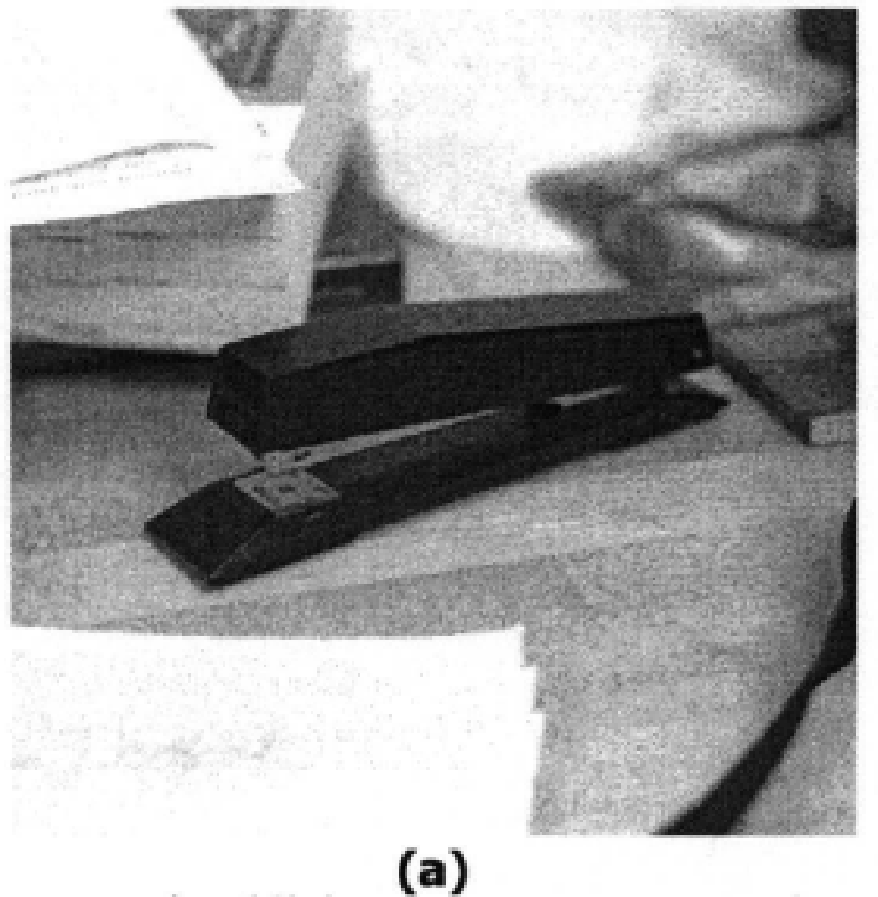
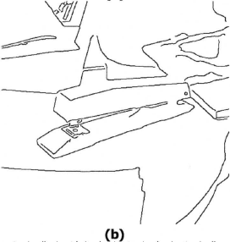
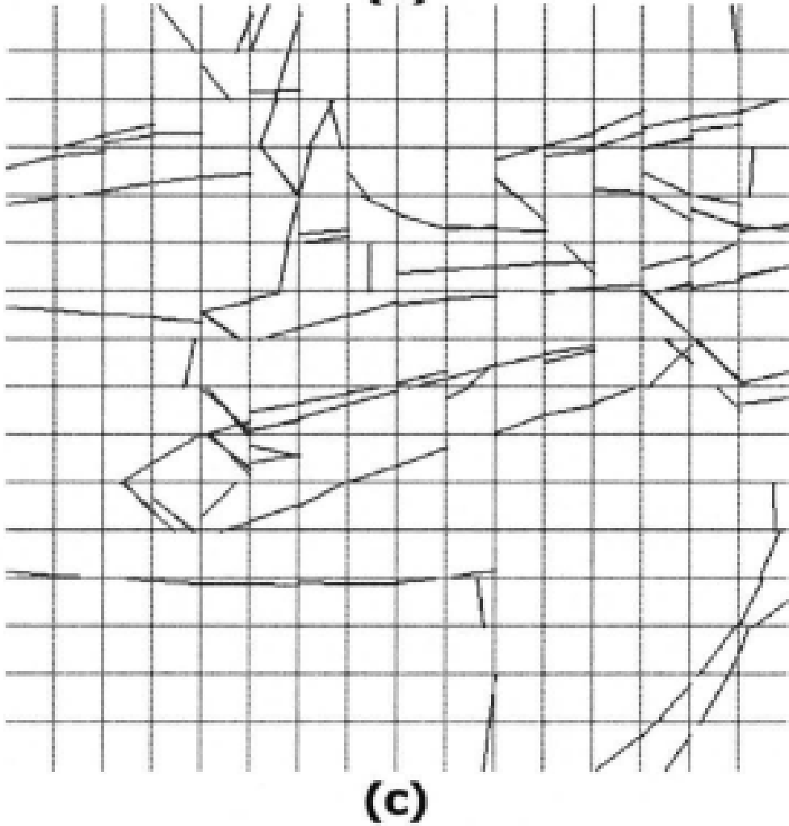



7.5 Example

Slide 27
References
Generalizing The Hough Transform to Detect Arbitrary Shapes – D H Ballard – 1981
Spatial Decomposition of The Hough Transform – Heather and Yang – IEEE computer Society – May 2005
Hypermedia Image Processing Reference 2 – http://homepages.inf.ed.ac.uk/rbf/HIPR2/hipr_top.htm
Machine Vision – Ramesh Jain, Rangachar Kasturi, Brian G Schunck, McGraw-Hill, 1995
Machine Vision - Wesley E. Snyder, Hairong Qi, Cambridge University Press, 2004

